Slide 1
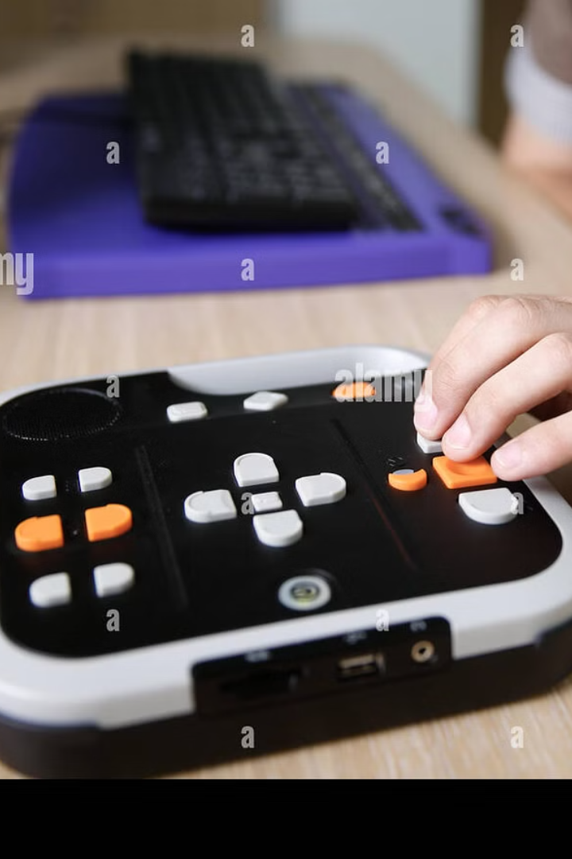
AI-Based Object Recognition & Assistance for the Blind
Using Image Recognition & Text-to-Speech (TTS)

Slide 2
Challenges & the Importance of AI
Challenges Faced
Why AI Matters
Difficulty identifying objects
AI-powered solutions can provide independence and accessibility for the visually impaired.
Dependence on others for navigation
Lack of accessible solutions
It can transform daily living and create more opportunities.

Slide 3

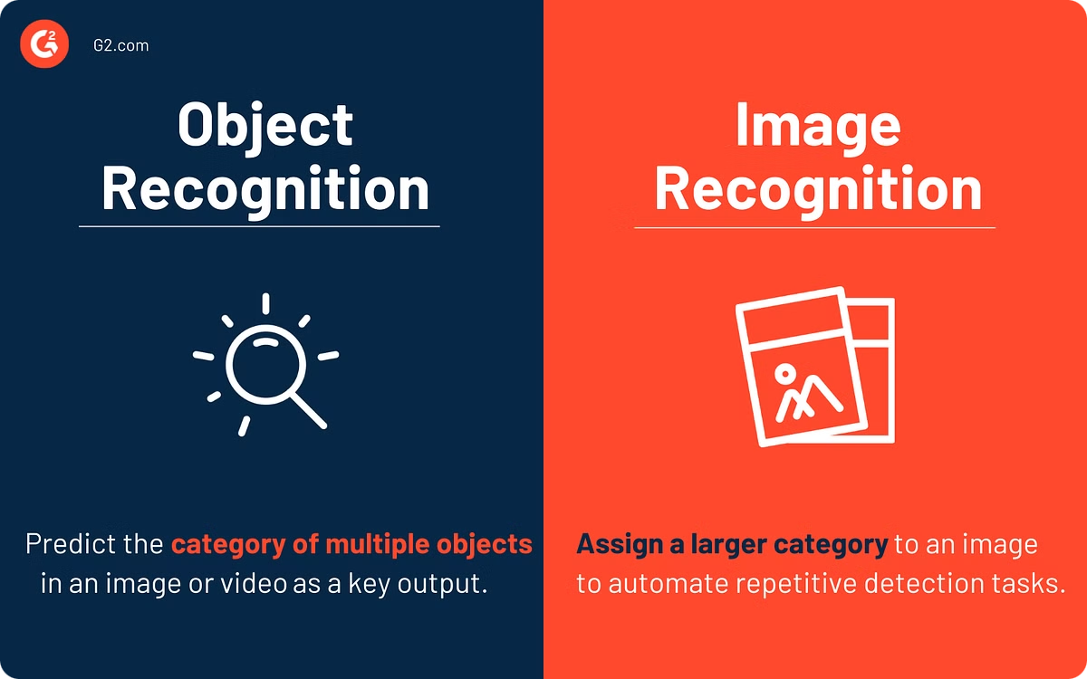
Our Solution: Enhancing Independence
1
Image Capture
2
AI Object Recognition
The application captures an image using a device's camera.
AI identifies objects within the image.
3
Text-to-Speech
Object names are converted to speech using TTS.

Slide 4

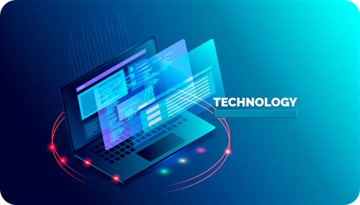
Technology Stack
Programming Language: Python
Libraries Used:
OpenCV (cv2) for image processing
Pyttsx3 & gTTS for text-to-speech conversion
NumPy for numerical processing
Pytesseract for OCR (Optical Character Recognition)
Pyzbar for barcode/QR code detection
Langdetect for language detection
OS & urllib for system and internet operations

Slide 5

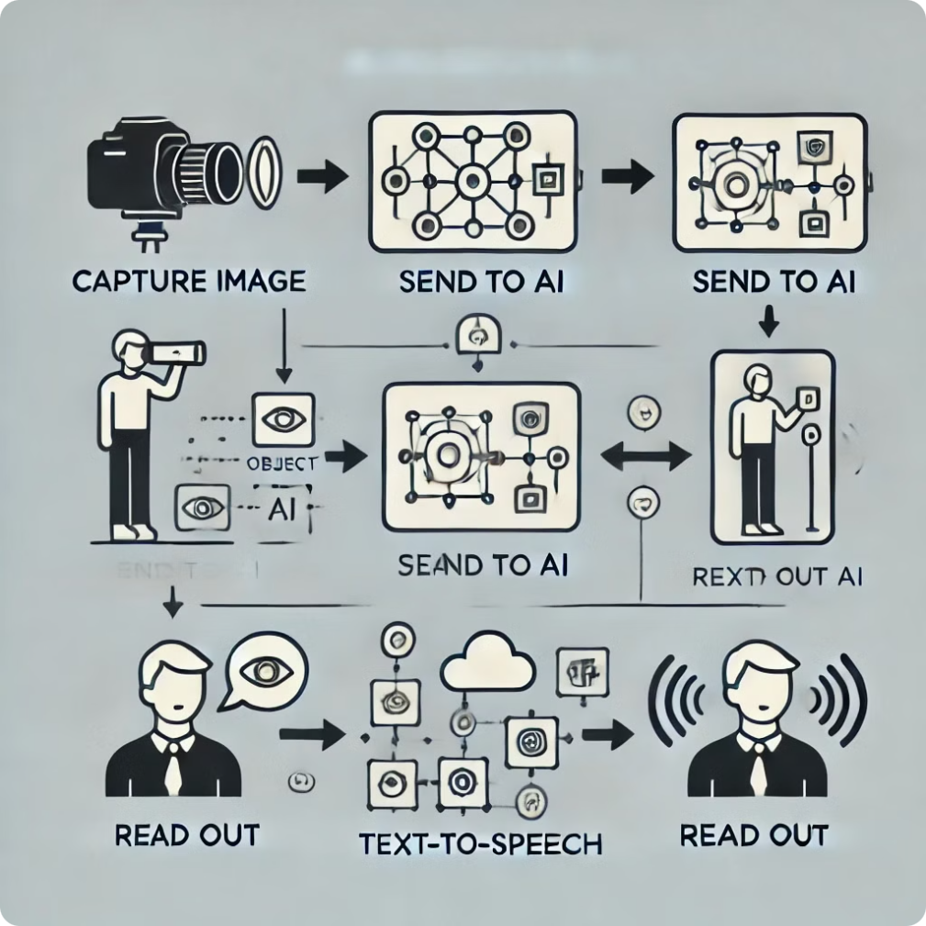




How It Works: A Simple Workflow
Capture Image
User captures an image.
Send to AI
Image is sent for recognition.
Identify Objects
AI identifies and labels objects.
Read Out
TTS reads out recognized object.

Slide 6




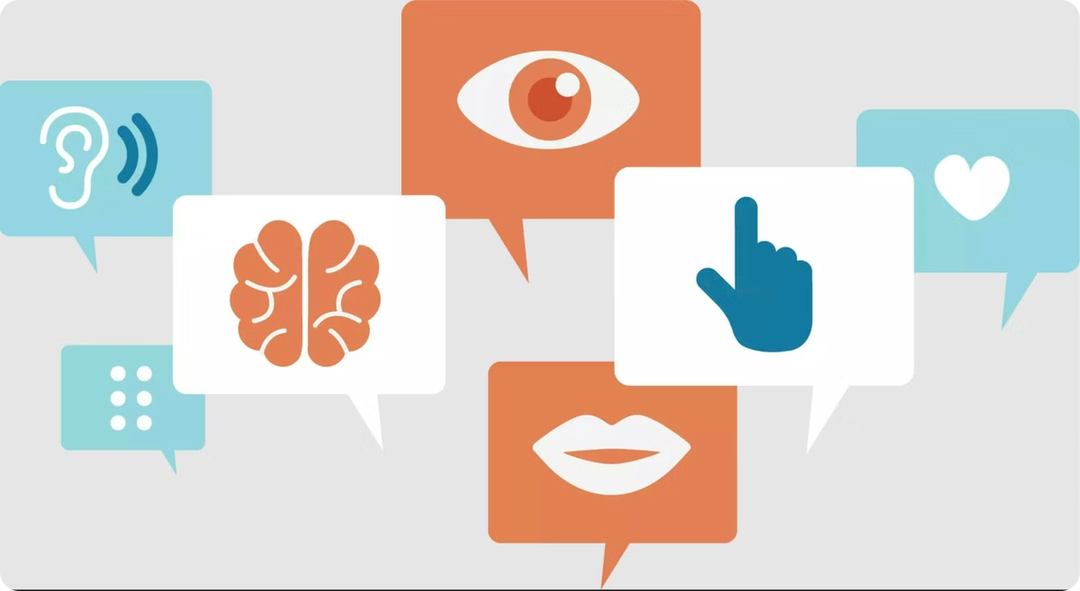
Key Features
Real-time Recognition
Audio Feedback
Accessible Design
Multi-Language Support

Slide 7

Use Cases & Future Scope
Education
1
Helps disabled students with their education.
2
Smart Glasses
Integrate with smart glasses.
Public Transport
3
Guidance in public spaces.
4
Voice Commands
Hands-free interaction through voice.

Slide 8

Conclusion:
This project is crucial in promoting inclusivity.
It bridges the gap for the visually impaired.
It's an important tool for independence.
Thank you for your time.

